Slide 1



UNIT-5 Graphs

Slide 2

Graphs
A data structure that consists of a set of nodes (vertices) and a set of edges that relate the nodes to each other
The set of edges describes relationships among the vertices .
A graph G is defined as follows:
G=(V,E)
V(G): a finite, nonempty set of vertices
E(G): a set of edges (pairs of vertices)

Slide 3



Examples of Graphs
V={0,1,2,3,4}
E={(0,1), (1,2), (0,3), (3,0), (2,2), (4,3)}
1
When (x,y) is an edge,
we say that x is adjacent to y, and y is adjacent from x.
is adjacent to 1.
is not adjacent to 0.
is adjacent from 1.
0
2
4
3

Slide 4

Types of graphs: Directed vs. Undirected Graphs
Undirected edge has no orientation (no arrow head)
Directed edge has an orientation (has an arrow head)
Undirected graph – all edges are undirected
Directed graph – all edges are directed
u
v
u
directed edge
v
undirected edge

Slide 5
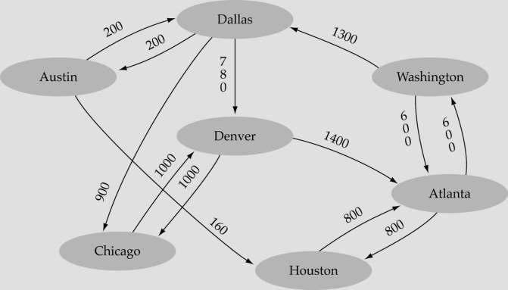
Weighted graph:
-a graph in which each edge carries a value

Slide 6

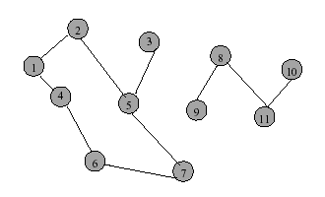
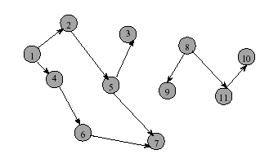
Directed graph
Directed Graph
Directed edge (i, j) is incident to vertex j and incident from vertex i
Vertex i is adjacent to vertex j, and vertex j is adjacent from vertex i
Undirected graph

Slide 7


Graph terminology
Adjacent nodes: two nodes are adjacent if they are connected by an edge
5 is adjacent to 7
7 is adjacent from
Path: a sequence of vertices th⁵at connect two nodes in a graph
A simple path is a path in which all vertices, except possibly in the first and last, are different.
Complete graph: a graph in which every vertex is directly connected to every other vertex

Slide 8

Continued…
A cycle is a simple path with the same start and end vertex.
The degree of vertex i is the no. of edges incident on vertex i.
e.g., degree(2) = 2, degree(5) = 3, degree(3) = 1

Slide 9

Continued…
Undirected graphs are connected if there is a path between any two vertices
Directed graphs are strongly connected if there is a path from any one vertex to any other
Directed graphs are weakly connected if there is a path between any two vertices, ignoring direction
A complete graph has an edge between every pair of vertices

Slide 10

Continued…
Loops: edges that connect a vertex to itself
Paths: sequences of vertices p0, p1, … pm such that each adjacent pair of vertices are connected by an edge
A simple path is a path in which all vertices, except possibly in the first and last, are different.
Multiple Edges: two nodes may be connected by >1 edge
Simple Graphs: have no loops and no multiple edges

Slide 11

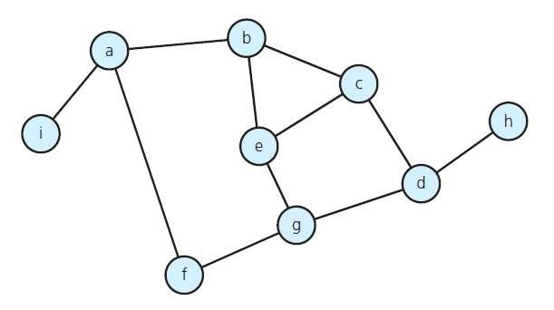
Graph Properties
Number of Edges – Undirected Graph
The no. of possible pairs in an n vertex graph is n*(n-1)
Since edge (u,v) is the same as edge (v,u), the number of edges in an undirected graph is n*(n- 1)/2.

Slide 12

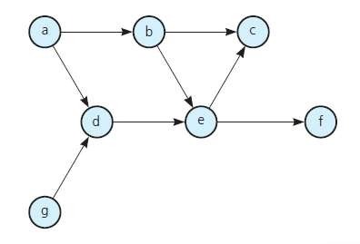
Number of Edges - Directed Graph
The no. of possible pairs in an n vertex graph is n*(n-1)
Since edge (u,v) is not the same as edge (v,u), the number of edges in a directed graph is n*(n-1)
Thus, the number of edges in a directed graph is ≤ n*(n-1)

Slide 13


DEGREE OF VERTEX
In-degree of vertex i is the number of edges incident to i (i.e., the number of incoming edges).
e.g., indegree(2) = 1, indegree(8) = 0
Out-degree of vertex i is the number of edges incident from i
(i.e., the number of outgoing edges). e.g., outdegree(2) = 1, outdegree(8) = 2

Slide 14

Graph Representation
For graphs to be computationally useful, they have to be conveniently represented in programs
There are two computer representations of graphs:
Adjacency matrix representation
Adjacency lists representation

Slide 15

Adjacency Matrix
A square grid of boolean values
If the graph contains N vertices, then the grid contains N rows and N columns
For two vertices numbered I and J, the element at row I and column J is true if there is an edge from I to J, otherwise false

Slide 16

Adjacency Matrix
0
1
2
3
4
0 | false | false | true | false | false
1 | false | false | false | true | false
2 | false | true | false | false | true
3 | false | false | false | false | false
4 | false | false | false | true | false
1
3
2
4
0

Slide 17

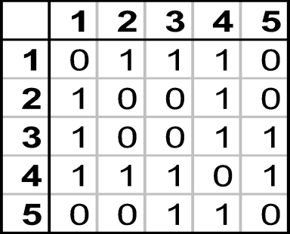
Adjacency Matrix
1
2
3
4
5

Slide 18
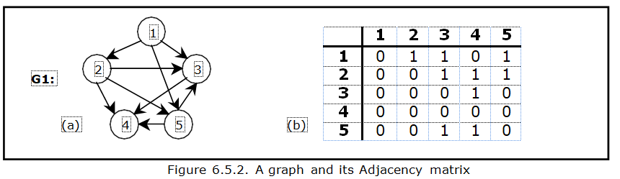
Example

Slide 19

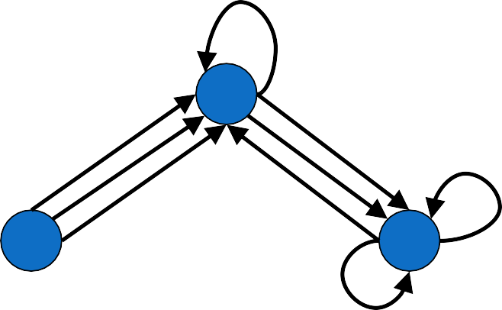
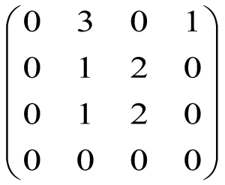
Adjacency Matrix
-Directed Multigraphs
2
1
4
3
A:
L23
18

Slide 20
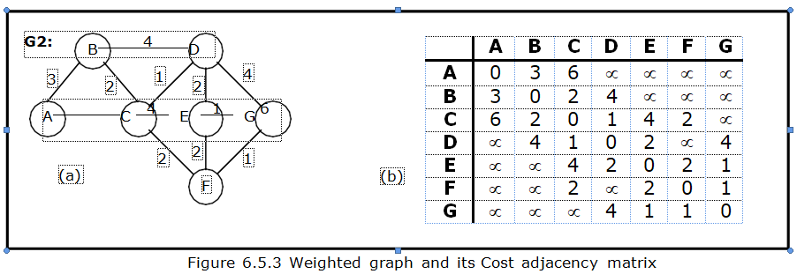
Directed Graph

Slide 21

Adjacency Lists Representation
A graph of n nodes is represented by a one- dimensional array L of linked lists, where
L[i] is the linked list containing all the nodes adjacent from node i.
The nodes in the list L[i] are in no particular order
21

Slide 22

Graphs: Adjacency List
Adjacency list: for each vertex v ∈ V, store a list of vertices adjacent to v
Example:
Adj[1] = {2,3}
1
Adj[2] = {3}
Adj[3] = {}
Adj[4] = {3}
Variation: can also keep
a list of edges coming into vertex
2
4
3
22

Slide 23

Graphs: Adjacency List
How much storage is required?
The degree of a vertex v = # incident edges
Directed graphs have in-degree, out-degree
For directed graphs, # of items in adjacency lists is
Σ out-degree(v) = |E|
For undirected graphs, # items in adjacency lists is Σ degree(v) = 2 |E|
So: Adjacency lists take O(V+E) storage
23

Slide 24
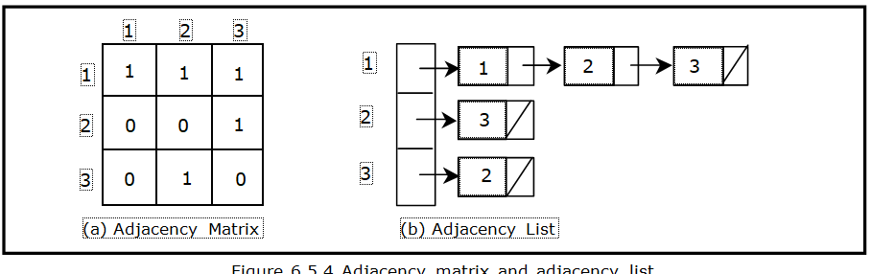
Example

Slide 25

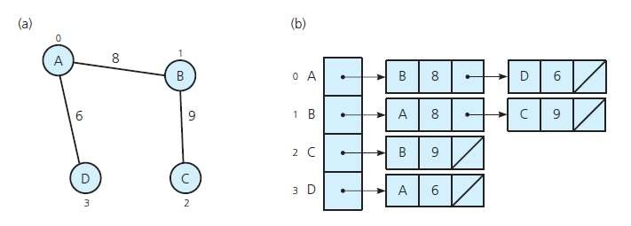
Implementing Graphs
(a) A weighted undirected graph and
(b) its adjacency list

Slide 26
Elimentary Operations on Graphs:
There are six primitive graph operations that provide the basic modules needed to maintain a graph. Implementation of each operation on graph is by updating adjacency list or adjacency matrix.
Insert a vertex : Add a vertex in graph. Initially it is disjoint. Vertex to be connected to graph by adding edge. Add a row in adj. matrix or add a node in adj. list
Delete a vertex: Delete vertex from graph. Delete a row from adj. matrix or delete a node from adj. list.

Slide 27
Contd…
Add an edge: Add an edge between 2 vertices. Update adj. matrix value to true/1 for respected edge or add a node in adj. list of vertex.
4. Delete an edge: Delete an edge from graph. Update adj. matrix value to false/0 for respected edge or delete a node in adj. list of vertex.
5. Find a vertex: Find the vertex in graph. Check if the required vertex is in adj. list or matrix.
6. Traverse a graph: Traverse the graph is display all vertices in graph by starting from any one vertex and traverse all vertices.

Slide 28
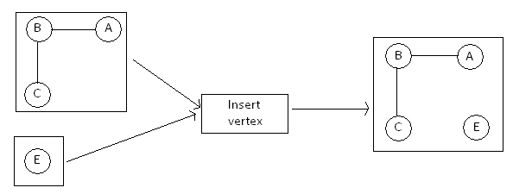
Insert vertex
 | A | B | C | E
A | 0 | 1 | 0 | 0
B | 1 | 0 | 1 | 0
C | 0 | 1 | 0 | 0
E | 0 | 0 | 0 | 0

Slide 29
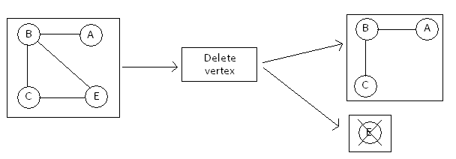
Delete a vertex
 | A | B | C
A | 0 | 1 | 0
B | 1 | 0 | 1
C | 0 | 1 | 0

Slide 30
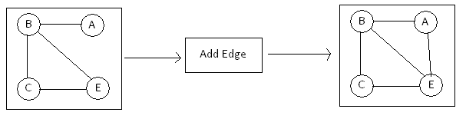
Insert an Edge
 | A | B | C | E
A | 0 | 1 | 0 | 1
B | 1 | 0 | 1 | 1
C | 0 | 1 | 0 | 1
E | 0 | 0 | 0 | 0

Slide 31
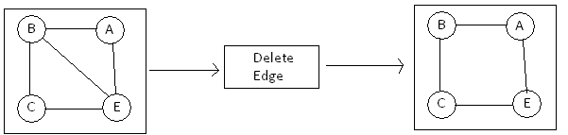
Edge Deletion
 | A | B | C | E
A | 0 | 1 | 0 | 1
B | 1 | 0 | 1 | 0
C | 0 | 1 | 0 | 1
E | 0 | 0 | 0 | 0

Slide 32
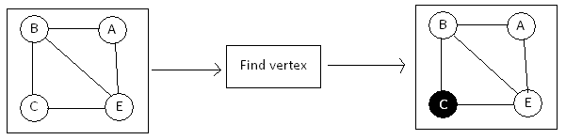
Find Vertex
 | A | B | C | E
A | 0 | 1 | 0 | 1
B | 1 | 0 | 1 | 1
C | 0 | 1 | 0 | 1
E | 0 | 0 | 0 | 0

Slide 33
Traverse
Two traversals of a graph are depth-first search (DFS) and breadth-first search (BFS). Since a graph has no root, we must specify a vertex at which to begin a traversal.
Depth-first search is essentially a generalization of the preorder traversal of a rooted tree.
The level-order traversal of a tree is an example of the breadth-first traversal.

